Slide 1
EXAM VISION

Slide 2

Project Statement
Human invigilation has limits and therefore can not monitor all students together during an exam. So there lies a gap where cheating can occur.

Slide 3
Methodology Of The Problem
Model Training: configure, train, adjust parameters, and fine tune our model.
Model Evaluation: calculate performance metrics, test model, and try real world testing.
Deployment: model optimization, integration with streamlit, and live demo through web app.

Slide 4
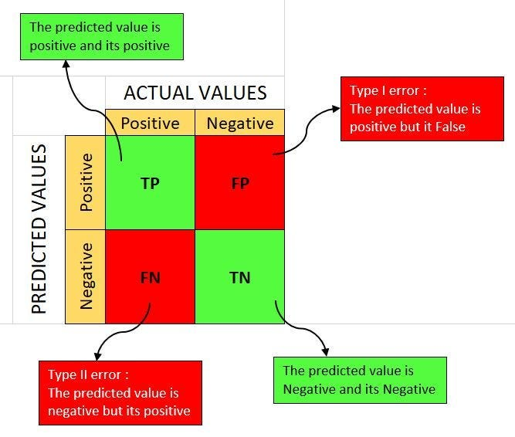
Confidence Score Overview

Slide 5
---relevelent graph here--
Human invigilation has limits and therefore can not monitor all students together during an exam. So there lies a gap where cheating can occur.

Slide 6
---relevelent graph here--
Opportunity to build
Fully inclusive market
Total addressable market
Freedom to invent
Selectively inclusive market
Serviceable available market
 | Clients | Orders | Gross revenue | Net revenue
20XX | 10 | 1100 | $10,000 | $7,000
20XX | 20 | 200 | $20,000 | $16,000
20XX | 30 | 300 | $30,000 | $25,000
20XX | 40 | 400 | $40,000 | $30,000

Slide 7
---relevelent graph here--
 | Year 1 | Year 2 | Year 3
Income
Users | 50,000 | 400,000 | 1,600,000
Sales | 500,000 | 4,000,000 | 16,000,000
Average price per sale | 75 | 80 | 90
Revenue @ 15% | 5,625,000 | 48,000,000 | 216,000,000
Gross profit | 5,625,000 | 48,000,000 | 216,000,000

Slide 8
Our Next Steps
Our product is priced below that of other companies on the market
Design is simple and easy to use, compared to the complex designs of the competitors
Affordability is the main draw for our consumers to our product
Company A product is more expensive
Companies B & C product is expensive and inconvenient to use
Companies D & E product is affordable, but inconvenient to use

Slide 9
Thank you
Danial Khan, CS211131
mkdanialkhan@gmail.com
Fareeha Altaf, CS211100
fareehaaltaf01@gmail.com

Slide 10
Product benefits
Online store and market swap

Slide 11
Product overview
Unique
First to market
Tested
Authentic
Only product specifically dedicated to this niche market
First beautifully designed product that's both stylish and functional
Conducted testing with college students in the area
Designed with the help and input of experts in the field

Slide 12

Growth strategy
Feb 20XX: roll out product to high profile or top-level participants to help establish the product
May 20XX: release the product to the public and monitor press release and social media accounts
Oct 20XX: gather feedback and adjust product design as necessary

Slide 13
Product overview
Our product makes consumer lives easier, and no other product on the market offers the same features
Gen Z (18-25 years old)
Reduce expenses for replacement products
Simple design that gives customers the targeted information they need
Close the gap
Target audience
Cost savings
Easy to use

